Slide 1
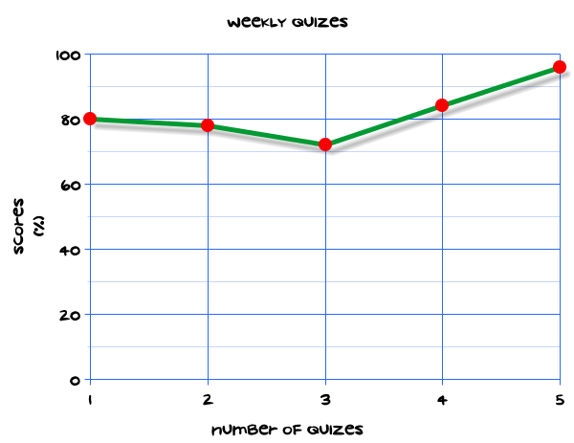
My Statistics Interactive Notebook
Name
Class
Teacher
Term 1 Semester 1
1

Slide 2
Create your own front page
It needs to contain the following –
My number interactive notebook
Name
Class
Teachers Name
Semester 1 Term 1
Page number 1

Slide 3
Contents
Glossary or Formula Page
Page
Date
Description
2
3

Slide 4
Tasks
24
7
30
Essential Question
Questions
Notes
Summary
4
5

Slide 5
24
7
30
Date
Title
EQ –
5

Slide 6
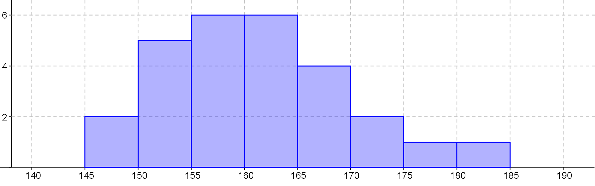
24
7
30
Date
Histograms
EQ – Describe the differences between histograms and bar charts?
What is a histogram?
A histograms shows the frequency for numerical data
Heights of students in 8-7
Frequency
Height(cm)
5

Slide 7
24
7
30
Date
Histograms
EQ – Describe the differences between histograms and bar charts?
What is a histogram?
A histograms shows the frequency for numerical data.
Heights of students in 8-7
Title
Frequency
No Gaps
Height(cm)
Labels
Scale
Use pencil and ruler
Notes:
iler

Slide 8
Questions

Slide 9
Notes Review
24, 7 ,30
Date
Title
Essential question
Notes complete
Notes complete with colour and diagrams
Questions completed
Contents page filled in
Formula page filled in

Slide 10
Homework
Review your notes and write a summary answering the essential question.

